Slide 1
MicroPython: The Next Steps to World Domination
Steve Holden
CTO, Global Stress Index Limited

Slide 2
Introductions
Started programming in 1968
Computational scientist by training
Engineer at heart, electronics hobbyist
Python user since Python 1.4
Enjoy helping people to learn

Slide 3
SOME HISTORY
Developments in Computing

Slide 4
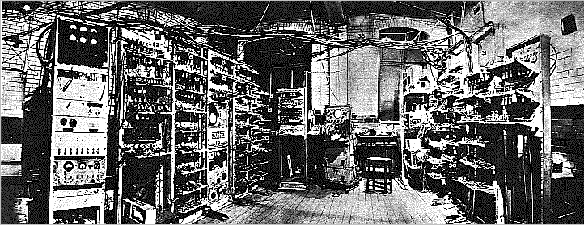
1948
Notes:
1.1KIPS == 0.0011 MMIPS (A thousandth of a MIPS)

Slide 5
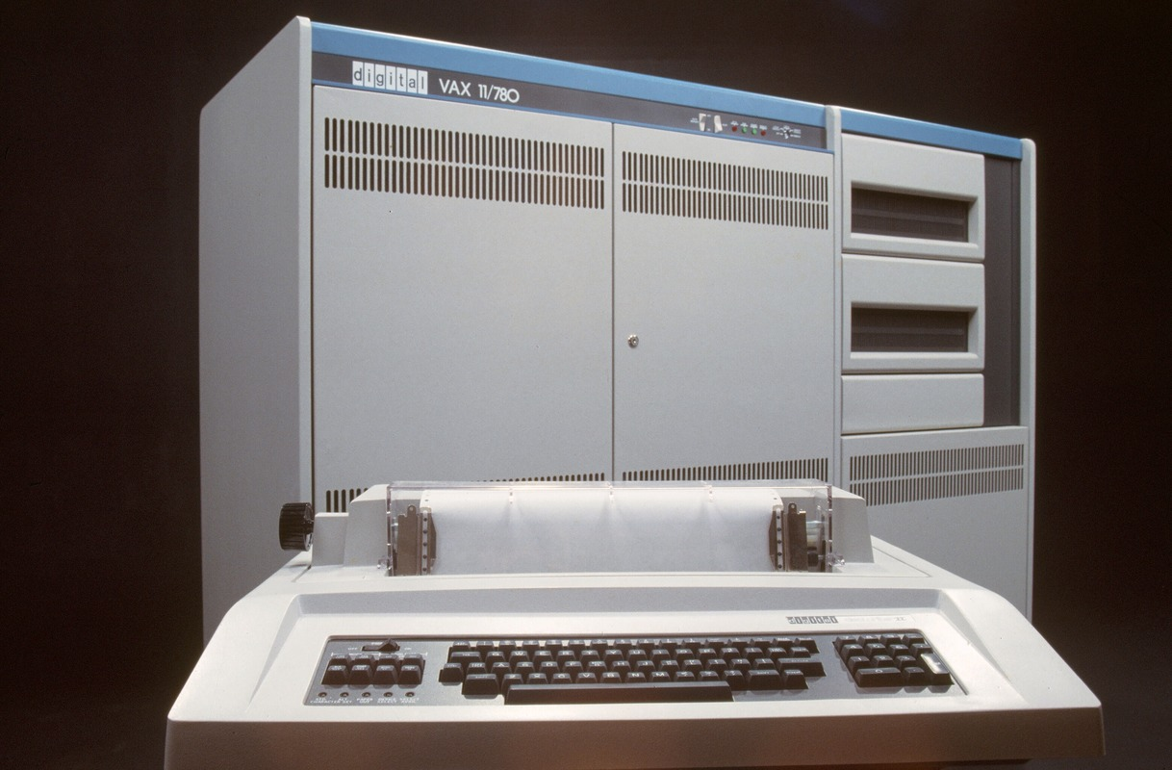
1977
Notes:
VAX 11/780 = 1 MIPS

Slide 6
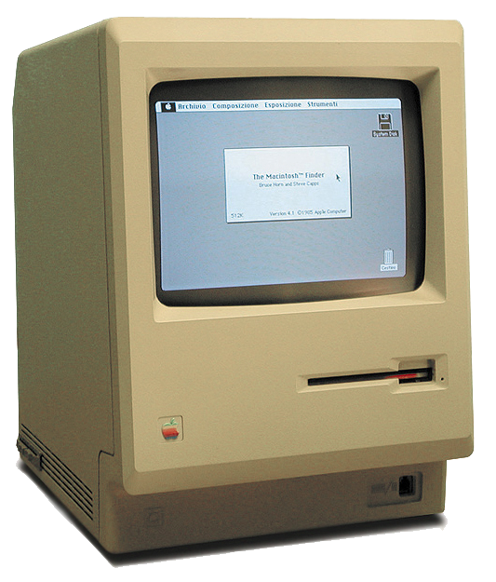
1984
Notes:
0.52 MIPS (36 years)

Slide 7
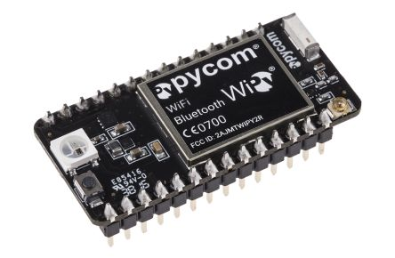
2015

Slide 8
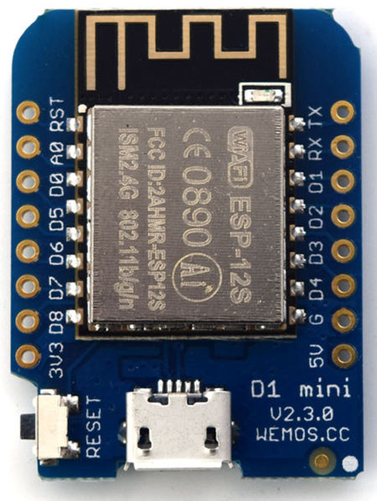
2016
Notes:
200 MIPS!!!!

Slide 9
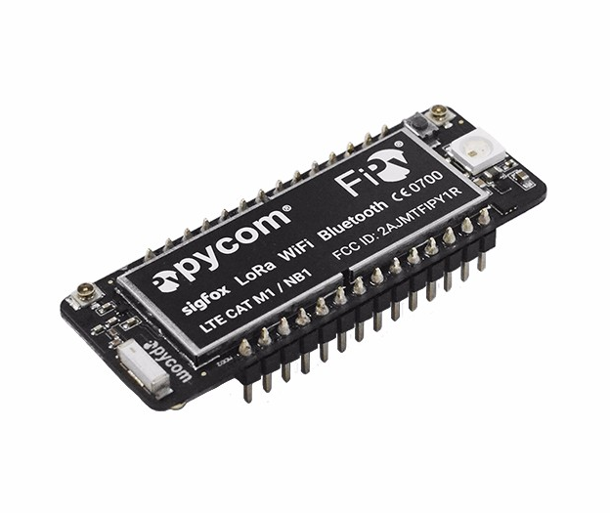
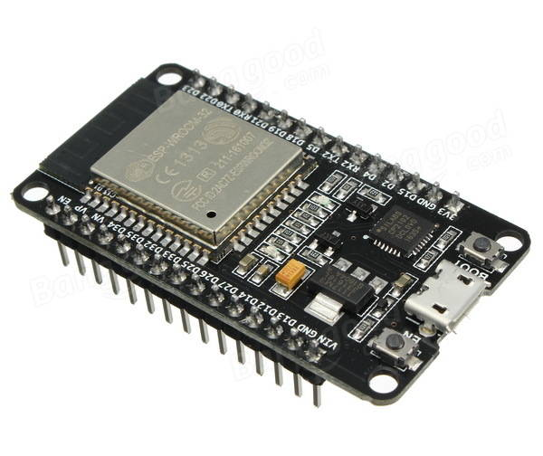
2017
Notes:
FiPy: Five networks: WiFi, Bluetooth, LORA, SigFox, LTE
ESP32: Wifi plus huge resources and 600 DMIPS!

Slide 10
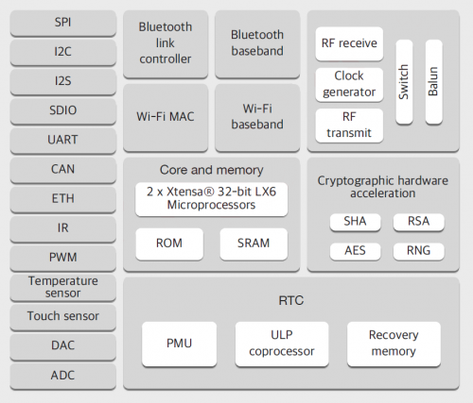
Some ESP32 Features
Twin-core CPU (200 MIPS)
Wifi and Bluetooth
Crypto acceleration
Touch sensing
A-to-D and D-to-A
Many comms interfaces

Slide 11
2020
?
Notes:
Who knows where we are going? These are crazy times!

Slide 12
The birth of the micro:bit
Python’s Popularity

Slide 13
20-Year Plan for World Domination
Help grow Python’s communities
Help underpin the Python Software Foundation
Profit? (and for whom?)
A million new users in a single year might help…

Slide 14
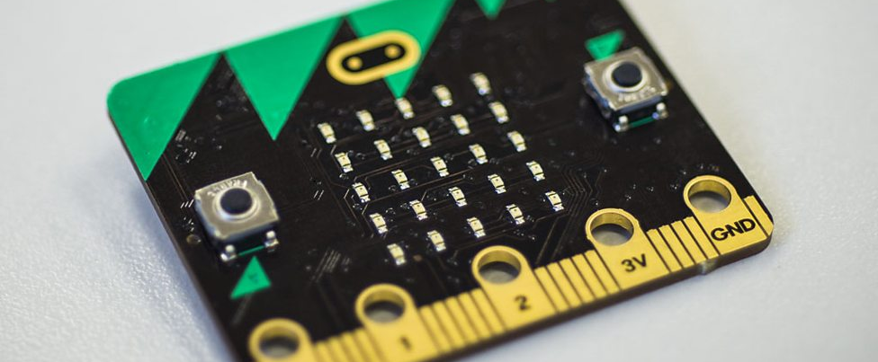
A Seminal Moment: 22.03.2016
Notes:
Date: 22.03.2016 Last updated: 29.03.2016 at 08.12
Category: Make It Digital
In a landmark moment, from today up to one million BBC micro:bits are being delivered free to every year 7 student in England and Wales, year 8 student in Northern Ireland and S1 student in Scotland. The BBC micro:bit, launched as part of the BBC Make it Digital initiative, is a pocket-sized codeable computer that allows young people to get creative with technology, whatever their level of experience, and aims to help develop a new generation of digital pioneers.

Slide 15
The BBC micro:bit
ARM Cortex M0 processor
256kB flash memory, 16kB static RAM
Accelerometer and Magnetometer
Bluetooth and USB connectivity
5 x 5 red LED matrix

Slide 16
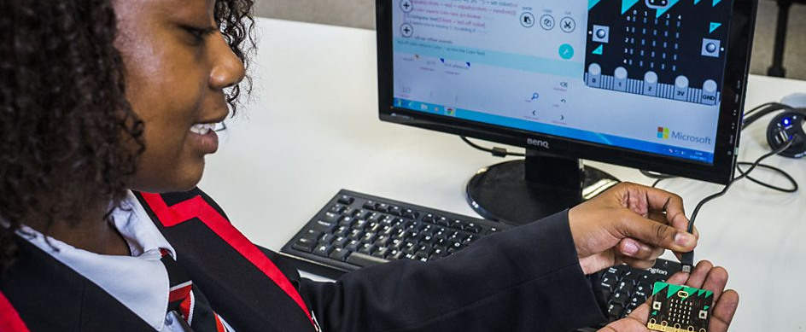
Goal: Python in Everyone’s Reach

Slide 17
Note to Purists
We are talking about learners
They do not need huge libraries
Direct hands-on experience enables
Large resources are not required
Large numbers of devices are

Slide 18
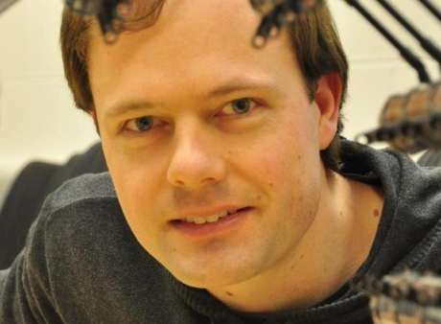
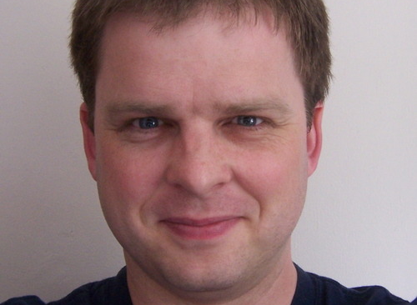
MicroPython
Damien George
Nick Tollervey
Notes:
Damien George, inventor of MicroPyhton
Nick Tollervey, developer of mu

Slide 19
How like Python is it?
The Language Itself

Slide 20
MicroPython Features
The entire Python 3.4 syntax, including
Exceptions
with , yield from, etc.
Also adds 3.5’s async and await
Optional machine code!
Types include str, bytes, bytearray, tuple, list, dict, set, frozenset, array.array, collections.namedtuple
Also, naturally, classes and instances

Slide 21
Supported Systems
PyBoard
WiPy
ESP8266
ESP32
STM32F4
NUCLEO boards
Espruino Pico

Slide 22
Filesystem
A small amount of EPROM appears as /flash
With hardware support you can also get /sd
One or the other becomes current directory
Can access via an abbreviated os module
open works as usual

Slide 23
Boot Sequence
boot.py is run
The USB interface is enabled
main.py is run
Most systems also allow a safe-mode boot
Helpful when you get boot.py wrong
Can reset the filesystem to factory settings

Slide 24
Paste Mode
Enter with ^E
Paste code in
Terminate entry and parse code with ^D

Slide 25
Installation (ESP8266 Systems)
# Get the MicroPython binary
wget http://micropython.org/resources/firmware/esp8266-20170823-v1.9.2.bin
# Ensure esptool is installed
pip install esptool
# configure for specific port
alias esptool="python -m esptool --port /dev/tty.wchusbserial1410"
# Erase flash and install the MicroPython image
esptool erase_flash
esptool --baud 115200 write_flash --flash_size=detect 0 \
esp8266-20170823-v1.9.2.bin

Slide 26
Commercial support
Zerynth’s Internet of Things Environment

Slide 27
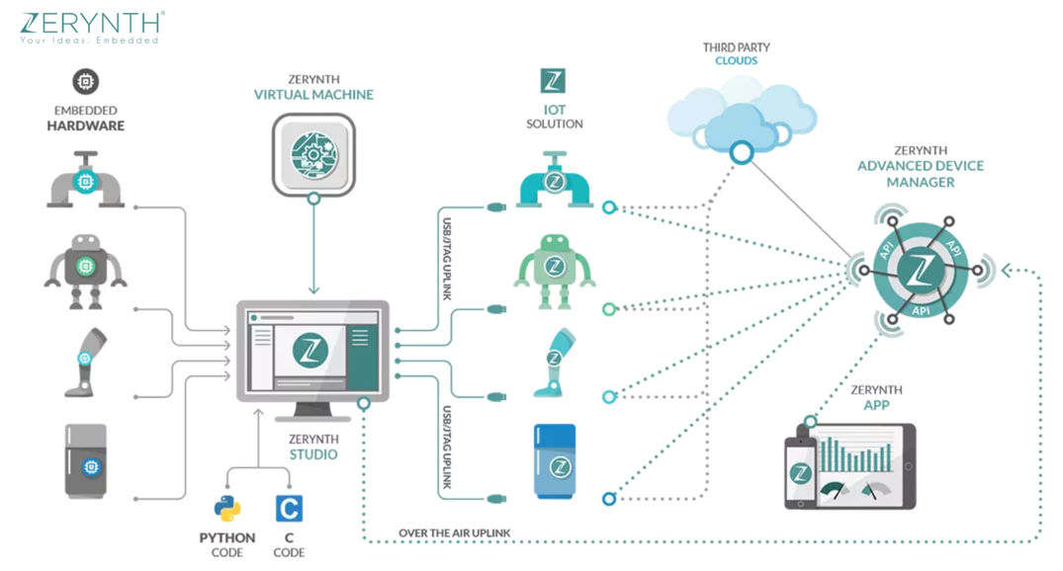
Zerynth: IoT with MicroPython and C

Slide 28
Zerynth MicroPython Features
Studio: an IDE
VM: real-time ‘OS’ – hardware independent
Advanced Device Manager
OTA updates and remote procedure calls
App: mobile phones to communicate directly with Python-programmed IoT devices

Slide 29
Zerynth Supported Systems
ESP8266
ESP32
Microchip/Atmel SAM*
Nordic NRF*
NXP K64
Particle Photon
33 different systems in all!

Slide 30
Some simple code examples
Show me the code!

Slide 31
Digital I/O
from machine import Pin
# Digital input
in_pin = Pin(0, machine.Pin.IN, machine.Pin.PULL_UP)
p = in_pin.value()
# Digital output
out_pin = machine.Pin(0, machine.Pin.OUT)
# Set of clear using the same method
out_pin.value(1) # sets it
Out_pin.value(0) # clears it

Slide 32
File Handling
# Files are stored in a FAT filesystem in flash memory or on an SD card
>>> f = open('data.txt', 'w')
>>> f.write('some data')
9
>>> f.close()
>>> f = open('data.txt')
>>> f.read()
'some data'
>>> f.close()

Slide 33
Simple Networking
def http_get(url):
_, _, host, path = url.split('/', 3)
addr = socket.getaddrinfo(host, 80)[0][-1]
s = socket.socket()
s.connect(addr)
s.send(bytes('GET /%s HTTP/1.0\r\nHost: %s\r\n\r\n' % (path, host), 'utf8'))
while True:
data = s.recv(100)
if data:
print(str(data, 'utf8'), end='')
else:
break
s.close()

Slide 34
Hobby Servomotor Control
import pyb
s1 = pyb.Servo(1) # create a servo object on position X1
s2 = pyb.Servo(2) # create a servo object on position X2
s1.angle(45) # move servo 1 to 45 degrees
s2.angle(0) # move servo 2 to 0 degrees
# move servo1 and servo2 synchronously, taking 1500ms
s1.angle(-60, 1500)
s2.angle(30, 1500)

Slide 35
Interrupt Handling
>>> def callback(p):
... print('pin change', p)
>>> from machine import Pin
>>> p0 = Pin(0, Pin.IN)
>>> p2 = Pin(2, Pin.IN)
>>> p0.irq(trigger=Pin.IRQ_FALLING, handler=callback)
>>> p2.irq(trigger=Pin.IRQ_RISING | Pin.IRQ_FALLING, handler=callback)

Slide 36
Power Control
import machine
# configure RTC.ALARM0 to be able to wake the device
rtc = machine.RTC()
rtc.irq(trigger=rtc.ALARM0, wake=machine.DEEPSLEEP)
# set RTC.ALARM0 to fire after 10 seconds (waking the device)
rtc.alarm(rtc.ALARM0, 10000)
# put the device to sleep
machine.deepsleep()
...
if machine.reset_cause() == machine.DEEPSLEEP_RESET:
print('woke from a deep sleep')
else:
print('power on or hard reset')

Slide 37
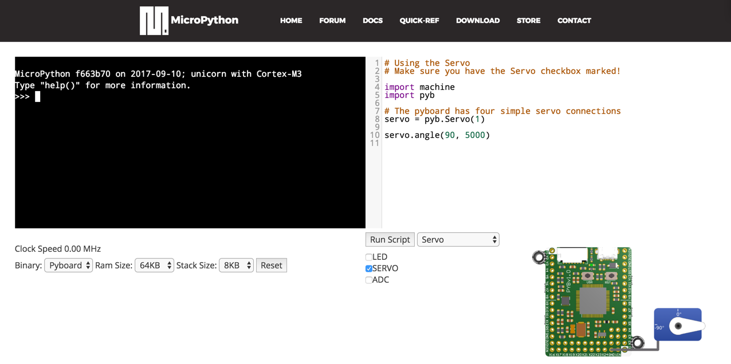
www.micropython.org/unicorn/

Slide 38
A Real-world problem
De-bouncing switches

Slide 39
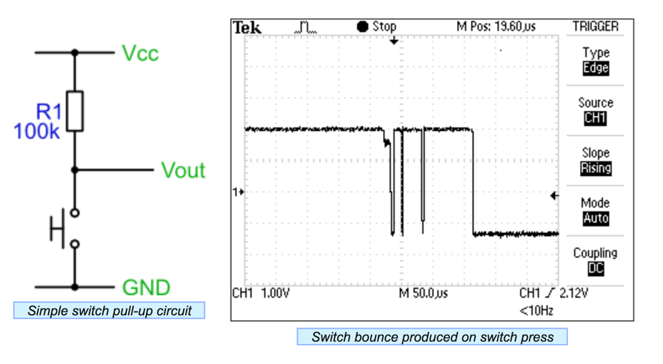
Switches Aren’t Just On/Off

Slide 40
Solving The Problem
Use a pure software solution
Sample at regular intervals
I chose a 6ms sampling interval
Switch is stable when N samples are the same
I chose N=12

Slide 41
Switch Class Definition
from machine import Timer, Pin
class Switch:
def __init__(self, pin_no, name):
self._state = 0
self.value = 0
self.pin = Pin(pin_no)
self.name = name
def output(self):
"Return name of switch if closed, dot if open."
return self.name if self.value else "."

Slide 42
Debouncer Class Definition (1)
class Debouncer:
def __init__(self):
self.switches = []
self.timer = Timer(-1)
self.timer.init(period=6, mode=Timer.PERIODIC, callback=self.tick)
def register(self, switch):
"Add a switch to the bank."
self.switches.append(switch)
switch.pin.init(mode=Pin.IN, pull=Pin.PULL_UP)
return switch
6 ms intervals

Slide 43
Debouncer Class Definition (2)
def tick(self, _):
"Examine input states and note debounced state changes."
for switch in self.switches:
bit = switch.pin.value()
switch._state = ((switch._state << 1) | bit) & 0xfff
# Latch state if last 12 samples were equal
if switch._state == 0x000: # switch pressed
switch.value = True
elif switch._state == 0xfff: # switch released
switch.value = False

Slide 44
Switch Setup on ESP8266
def switches():
"Report names of closed switches."
return "".join(x.output() for x in (R, W, B, Y))
# Create a bank of four debounced switches
d = Debouncer()
Y = d.register(Switch(0, "Y")) # D3
R = d.register(Switch(14, "R")) # D5
W = d.register(Switch(12, "W")) # D6
B = d.register(Switch(13, "B")) # D7

Slide 45
Main Loop
# Background task loops reporting changes in any switch's state
state = switches()
while True:
new_state = switches()
if new_state != state:
state = new_state
print(state)

Slide 46
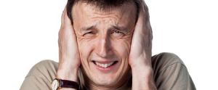
Live Demonstration!

Slide 47
Possibilities …
Robot control
Toys and games
Weather stations
Light patterns
Science instrumentation/data collection

Slide 48
Final Thoughts
Computers don’t just belong in mathematics
MicroPython gives children direct, hands-on experience
Puts them in control
The younger they start, the more useful they will find computers

Slide 49
Questions?
Contact me:
sh@felix.com
@holdenweb
Slides and code available at
http://github.com/holdenweb/PyConIE2017

Slide 50
More Resources
github.com/micropython/
github.com/micropython/micropython/wiki
www.micropython.org/download
twitter.com/search?q=#micropython

